Slide 1
Membership Research Projects
2023: Business Plan Project 1A/B

Slide 2
Presentation Format
1
2
Methodology
Summary
Findings
3
4
Conclusions and
Recommendations
Questions

Slide 3
Two points to remember

Slide 4
Methodology
​​
Composition
Qualitative
Project 1B
Project 1A
Membership: August 2023
Finance: April 2021
STS: September 2023
Schemes: August 2023
Attrition: August 2023
17,597 data points collected and reviewed
219 members contacted
Two focus groups staged
Eight in-depth interviews conducted
Subjective, descriptive, emotive
Composition report: September
Progressive Partnership report: 5 October
Final merged report V1: 11-13 October
Margin of error: 95% +/-9.5% confidence
497 members contacted
102 CATIs conducted
17 August-6 September
Objective, statistical, structured
Project 1AB
Project 1A
Reporting
Quantitative

Slide 5
Summary Findings: Composition

Slide 6
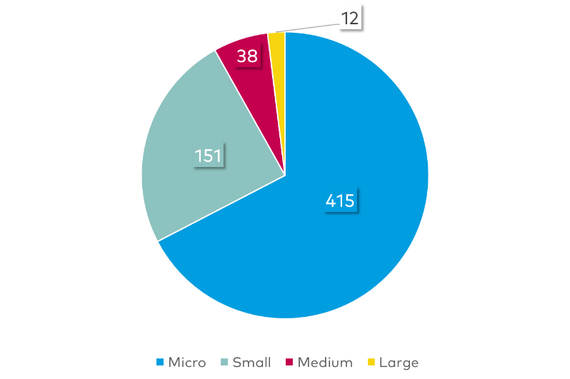
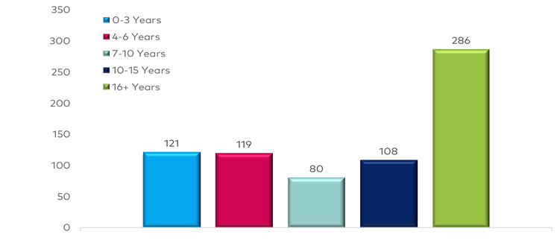
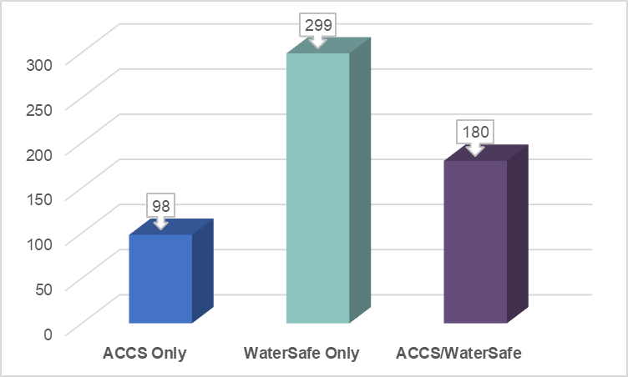
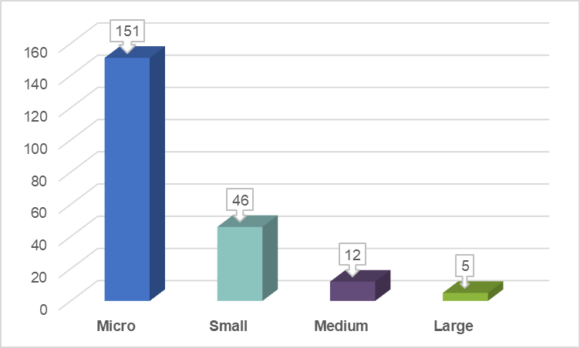
Membership
Duration
Size of company
Summary Findings
17%
17%
11%
15%
40%
Scheme Membership
Membership use of STS

Slide 7
Membership
Attrition: 20 years
Summary Findings

Slide 8
Summary Findings: Membership

Slide 9
Reasons to join SNIPEF or retain membership
Summary Findings

Slide 10
Describe SNIPEF
Positive
Recognised (within the profession)
Helpful
Well-known (within the profession)
Trustworthy
Negative
Old-fashioned
Not visible (within the public)
Dated
Not very informative
Summary Findings

Slide 11
Which services and benefits have you used?
Summary Findings

Slide 12
Value Statements
Positive: Agree and Strongly Agree
Summary Findings

Slide 13
Value Statements
Negative: Agree and Strongly Agree
Summary Findings

Slide 14
Impact Statements
Where does SNIPEF provide the greatest impact?
Summary Findings

Slide 15
Impact Statements
Future Priorities
Promote training in green technologies
Be the authoritative voice for the profession
74%
67%
Promote accreditation for the installation of green technologies
Better support members with valued services and benefits
71%
66%
Summary Findings
Promote increased employment in the sector
Ensuring member compliance with legislation and regulation
69%
64%
Create and launch upskill pathways for experienced operatives
Trusted go-to source for guidance and information
67%
63%
Maintain and enforce professional standards
Review competency requirements for SNIPEF members to maintain membership
67%
62%

Slide 16
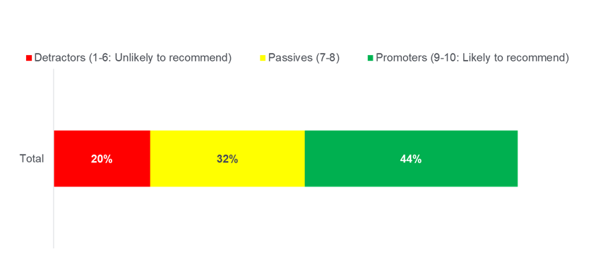
Would you recommend SNIPEF?
Summary Findings
Note: 4% answered Do Not Know
NPS: 24
(22-36)

Slide 17
Outcome
Statement
Research Executive
Statement
“SNIPEF is valued for its reputation, training and schemes but needs enhanced membership engagement, particularly for new members”
“SNIPEF has a core of loyal, long-standing members but has issues with membership attrition, particularly in the first few years. The value of SNIPEF’s schemes and training is evident, but there are concerns about poor and outdated engagement, especially for newer members”
Top Line Conclusions

Slide 18
01
Schemes
These are significant value propositions and need expanding. Many seem to believe you must remain in SNIPEF to maintain these services.
Delivering Apprentice Training
02
What is SNIPEF
good at?
Notably for micro companies. Many also believe SNIPEF membership is required to access SNIPEF Training.
Conclusions
03
Reputation
02
Maintaining a long-standing reputation within the industry.

Slide 19
01
Engagement
New member engagement and communication. Also some minor STS issues
Digital Offering
02
Recognise and replicate trends within third-sector organisations
What must SNIPEF
improve?
Conclusions
03
On-site Presence
02
Increase face-to-face contact
Communications
04
Clearly convey the full scope of benefits that members want

Slide 20
01
Attrition
High attrition rates within 0-3 years and 20+ years of membership
What should SNIPEF
be concerned about?
Retirement Wave
02
Conclusions
Potential retirement wave among older micro companies
03
Engagement
02
Engagement issues with new members

Slide 21
01
Events
Members show a disinterest in events. Some Associations have a track record of success. Review delivery.
Outdated Training Modules
02
Feedback from focus groups highlighted the need for relevant training and concerns about the outdated apprenticeship curriculum.
What should SNIPEF
move away from?
Generalist Campaigning
Conclusions
03
02
Campaigning on national issues was seen as less impactful, targeted campaigning, especially concerning sector-specific issues. might be more effective.
Broad Thought Leadership
04
General thought leadership dilutes effectiveness. Instead, SNIPEF should focus on areas directly impacting the profession and their members.
05
Traditional Communications
02
SNIPEF should consider strategies beyond conventional media and prioritise modern and/or digital marketing channels to enhance visibility and engagement.

Slide 22
Part One
01
Improve engagement and communication strategies (SNIPEF & STS)
SNIPEF must prioritise improving its engagement and communication channels, particularly with newer members and micro-businesses.
Brand and image reinforcement
SNIPEF should undertake a brand reinforcement campaign, repositioning the organisation as forward-thinking, focussed and modern.
02
Recommendations
03
Tailored offerings and programs to match the needs of members
Recognising the diverse needs of members based on company size and demographics, SNIPEF should review how it can introduce tailored programs.
Holistic review of SNIPEF services and departments to better meet corporate and member needs
Functions and responsibilities throughout SNIPEF should be reviewed and
repositioned to benefit the organisation.
04

Slide 23
Part Two
01
Increase the future pool of talent entering the profession.
Apart from being a perceived mandate of SNIPEF, this activity could help address both SNIPEF’s and SNIPEF Training’s ‘U-curve’ issue.
Reposition & and reinforce SNIPEF’s position as the authoritative
centre of plumbing and heating excellence
Merge tradition with innovation: SNIPEF should position itself as the primary
authority on plumbing and heating concerns.
02
Recommendations
03
Create clear water between SNIPEF, pensions and SNIJIB
Commentary throughout the research mistakenly laid blame on issues ie. pension and wages, at the doorstep of SNIPEF. Where possible, SNIPEF should try to create some distance.

Slide 24
Membership Research Projects
2023 Business Plan Project 1A/B

